Slide 1
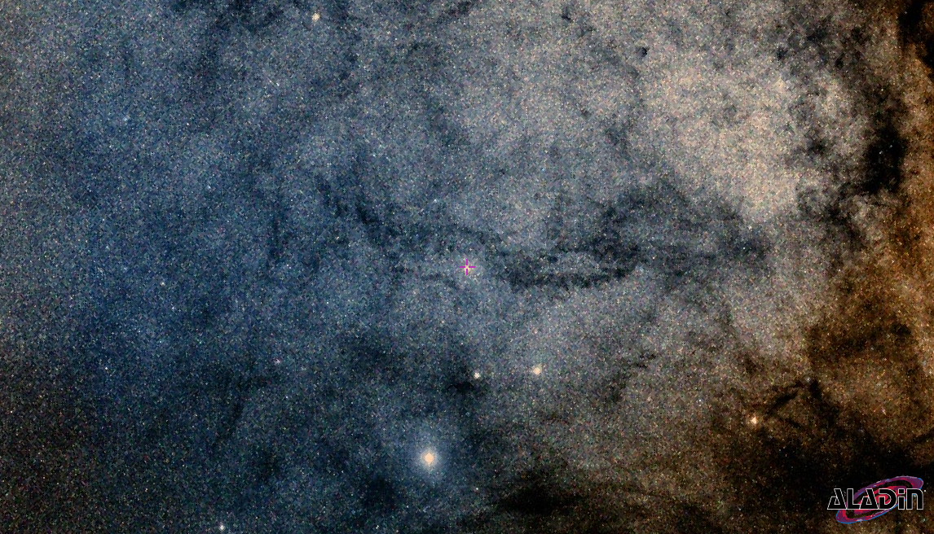
Improved Reddening, Distance and Luminosities of a new sample of Galactic Cepheids for probing the Milky Way and calibrating the extra-galactic distance scale
Shubham Mamgain

Slide 2
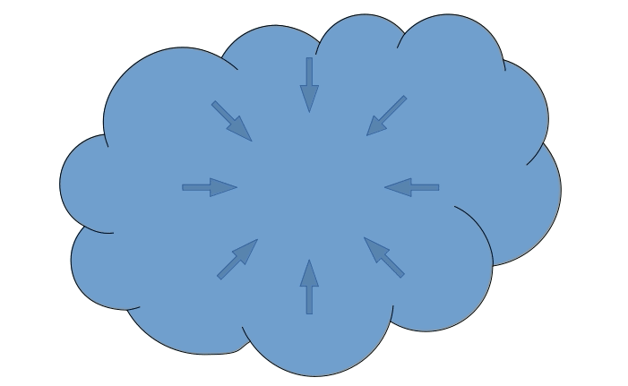
Background . Dataset . Method . Result . Validation . Conclusion . Summary
Star Formation

Slide 3
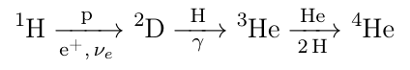
Background . Dataset . Method . Result . Validation . Conclusion . Summary
Main Sequence Star
Core Temperature > 10 MK - Nucleosynthesis
High Velocity of Particles
Overcome electrostatic repulsion
Nuclear Spin: ½ 1 ½ 0
Nuclear Fusion energy halts gravitational collapse
Thermal electromagnetic radiation
Luminosity is proportion to the mass

Slide 4
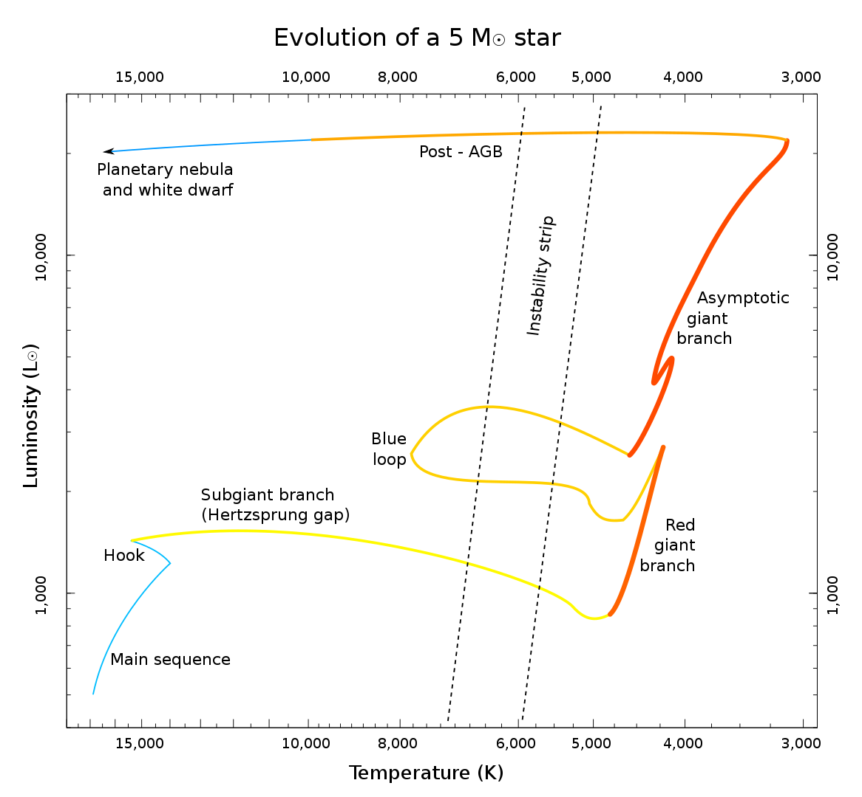
Background . Dataset . Method . Result . Validation . Conclusion . Summary

Slide 5
Background . Dataset . Method . Result . Validation . Conclusion . Summary
First Dredge UP

Slide 6
Background . Dataset . Method . Result . Validation . Conclusion . Summary
Second Dredge UP

Slide 7
Background . Dataset . Method . Result . Validation . Conclusion . Summary
Helium Flash

Slide 8
Background . Dataset . Method . Result . Validation . Conclusion . Summary
Instability Strip Crossing

Slide 9
Pulsation of Cepheid
Background . Dataset . Method . Result . Validation . Conclusion . Summary
III Dredge UP

Slide 10
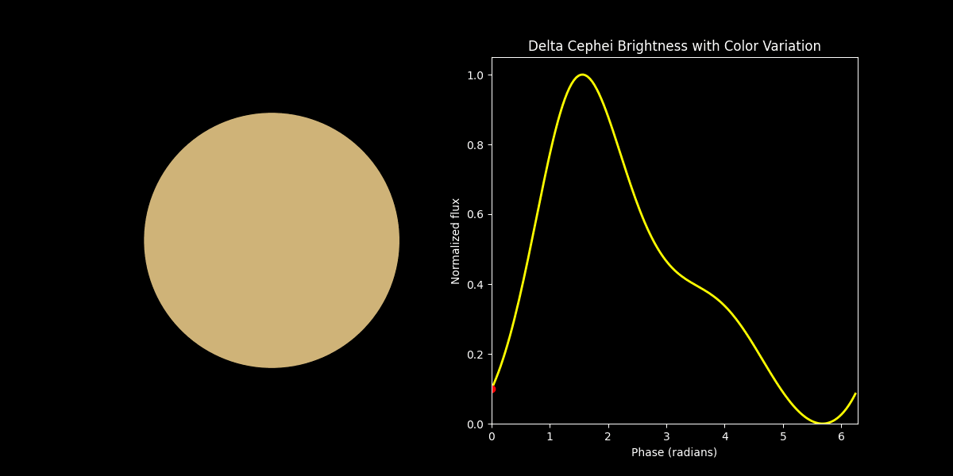
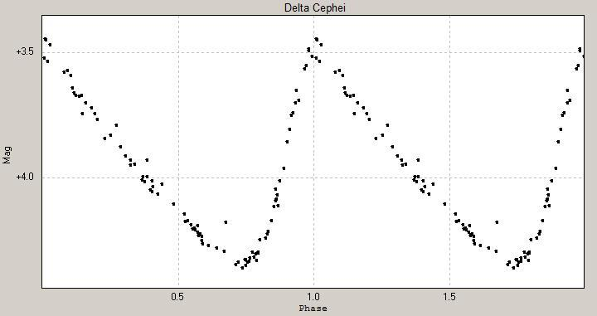
Background . Dataset . Method . Result . Validation . Conclusion . Summary

Slide 11
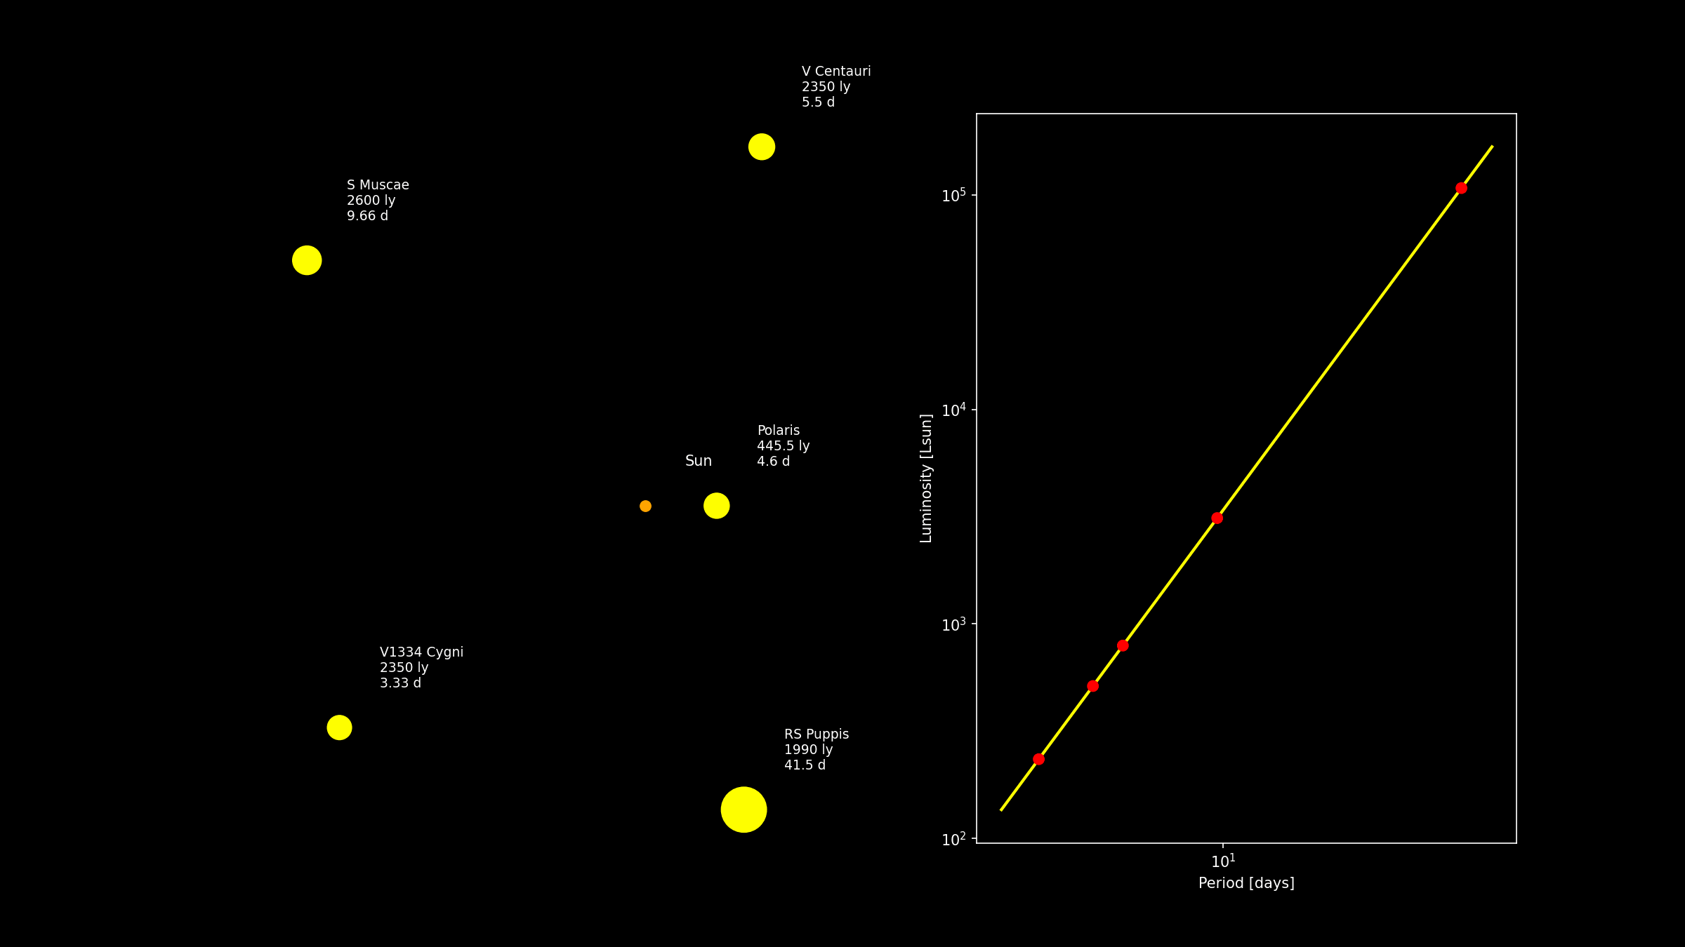
Background . Dataset . Method . Result . Validation . Conclusion . Summary

Slide 12
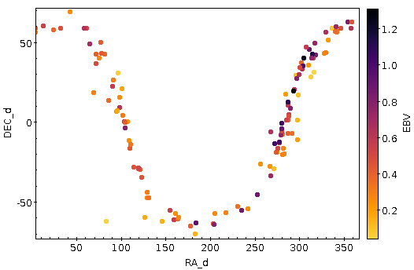
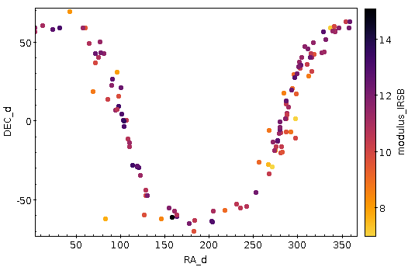
Cepheid Sample
Background . Dataset . Method . Result . Validation . Conclusion . Summary
MW - 150
OT - 21

Slide 13
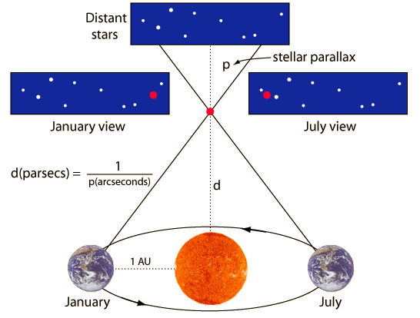
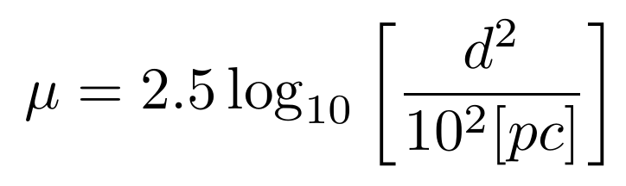
Background . Dataset . Method . Result . Validation . Conclusion . Summary
InfraRed Surface Brightness
Parallax

Slide 14

Background . Dataset . Method . Result . Validation . Conclusion . Summary
d
0 pc
L’ = L / d²
L = σ AT⁴

Slide 15
Distance - Luminosity
Background . Dataset . Method . Result . Validation . Conclusion . Summary
d
10 pc
0 pc
µ
0 mag
mλ⁰
Mλ⁰

Slide 16

Background . Dataset . Method . Result . Validation . Conclusion . Summary
d
10 pc
0 pc
d’
µ
0 mag
µ’
mλ
Mλ⁰
Mλ
Aλ
Reddening due to absorption of light

Slide 17
Reddening - Distance - Luminosity
Background . Dataset . Method . Result . Validation . Conclusion . Summary
d : Distance (in parsec)
10 pc
0 pc
d’
µ : Distance Modulus (in magnitude)
0 mag
µ’
Interstellar dust
Rλ
Absolute
True Position
Extinction
Apparent
Absolute
Distance
µ
True
Color Excess
E(B-V)
mλ
Mλ⁰
Mλ
Aλ
Aλ = Mλ - M⁰λ
= mλ– m⁰λ
= Rλ E(B-V)

Slide 18
10 pc
0 mag
µ µλ’
←δμλ→
mλ (Apparent magnitude) = Aλ (Extinction) + µ (Modulus) + Mλ⁰ (True Absolute)

Slide 19
Background . Dataset . Method . Result . Validation . Conclusion . Summary

Slide 20
Background . Dataset . Method . Result . Validation . Conclusion . Summary
dL : Distance (in parsec)
10 pc
0 pc
δdλ
µL : Distance Modulus (in magnitude)
0 mag
µ
δµλ
Color Excess
E(B-V)
Rλ
Absolute
Reddening Ratio
True Position
Apparent
Absolute
Distance
µ
True
Extinction
mλ
Mλ⁰
Aλ
Mλ

Slide 21
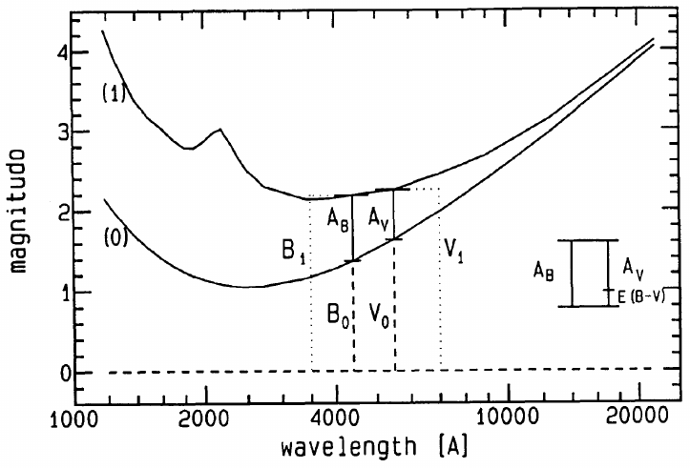
Reddening-free Magnitude
Visual Band
Blue Band
E(B-V) = AB - AV
E(B-V) = AB - AV
AV / E(B-V) = RV
= +

Slide 22
Mλ
M⁰λ
Absolute Magnitude
True Absolute Magnitude
mλ
µ
Aλ
Apparent Magnitude
Distance Modulus
Extinction
Luminosity
Distance
Reddening
mλ (Apparent magnitude) - µ (Modulus) - Aλ (Extinction) = Mλ⁰ (True Absolute)

Slide 23
Reddening-free Magnitude
Rλ
W
W⁰

Slide 24
Reddening-free Magnitude

Slide 25
Galactic Cepheid

Slide 26
Galactic Cepheid Sample

Slide 28
PW
(Δ-Δ)λ
logP
(PL)λ

Slide 29
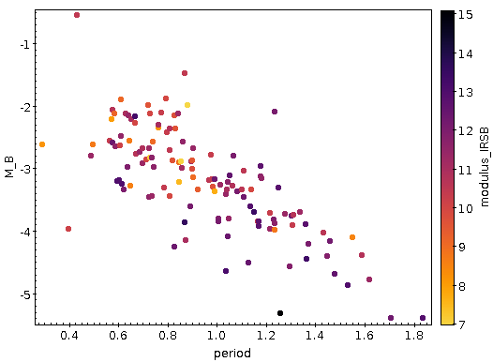
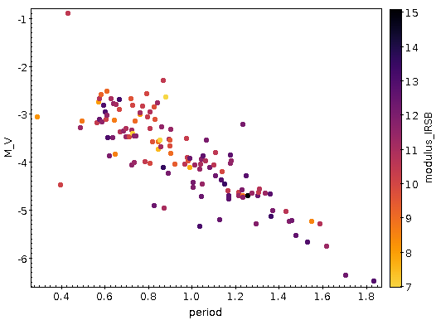
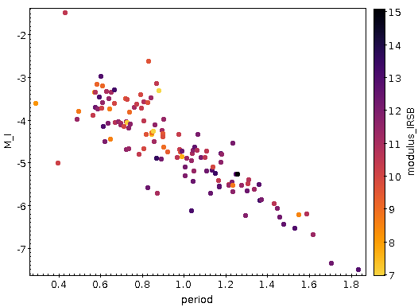



Period Luminosity Relation
Period-Luminosity

Slide 30
From all Cepheids
B
V
I
J
δAλ
H
Slope = αλ
K
ΔΜ
ΔMλ
ΔW
ΔW

Slide 31
δA^{i}λ

Slide 32
Possible correction in extinction for given modulus:
δAλ
Slope = αλ
δAλ = Δm – αλ(ΔW)
Δm
What if distance modulus require correction?
ΔW

Slide 33
δμ⁴
Slope = 1
Let there is δμ correction required in modulus, then
δμ³
m = M0 + µ + δμ + Aλ + δAλ
δμ²
Slope = αλ
δμ¹
W = M + RV (B - V) + µ + δμ
Deviation from PL relation
Apparent mag is sensitive to reddening and modulus, however, Wesenheit mag is sensitive to modulus only.
δμ⁴
δμ²
δμ¹
δμ³
Deviation from PW relation
Implies, star will shift in the line of slope 1 for modulus adjustment

Slide 34
B
V
I
J
H
K
ΔMλ
ΔW

Slide 35
For each Cepheid
δAλ / Rλ
RMS
δμ
δμ

Slide 36
B
V
δμ⁴
Slope = 1
a)
δμ³
b)
I
c)
J
δμ²
H
K
δμ¹
δAλ⁴
δAλ³
δE(B-V) = δAλ / Rλ
δΕ rms
Deviation from PL relation
δAλ
δAλ²
δAλ¹
Suggested modulus correction
Deviation from PW relation
Adjustment in modulus, δμ
δμ
Adjustments in µ lead to corrections in extinction
Resulting δE for δµ in all bands
Least rms in δE yields µ correction

Slide 37
M⁰λ
(δμ, δEBV)

Slide 38
Calibration procedure
IV
B
V
I
J
II
From all Cepheids
δAλ
H
Rλ
Slope = αλ
ΔMλ
K
PW
ΔΜ
W
W⁰
ΔW
(Δ-Δ)λ
ΔW
III
logP
V
(PL)λ
I
Mλ
M⁰λ
For each Cepheid
δAλ / Rλ
RMS
mλ
µ
Aλ
VI
δμ
δμ
M⁰λ
(δμ, δEBV)

Slide 39
Resource
Slide Number | Content | Source
2 | Light Curve | ThomasK Vbg, wikipedia
29 | Blackbody curve | 1993 The Interstellar Extinction Curve

Slide 40
Star Formation
Local minima of spacetime curvature

Slide 41
Star Formation
Local minima of spacetime curvature
Gravitation collapse of (molecular) gas cloud

Slide 42
Star Formation
Local minima of spacetime curvature
Gravitation collapse of (molecular) gas cloud
Protostar core getting denser and warmer

Slide 43
Star Formation
Local minima of spacetime curvature
Gravitation collapse of (molecular) gas cloud
Protostar disk forms, denser and warmer
Temperature: 100-10,000 K

Slide 44
Astronomical Standards
Sun as a standard star :
Luminosity 1 M
Mass 1 M
Radius 1 R
Distance 1 AU
Metallicity 1 [Fe/H]
Sun-type Star

